Slide 1

Welcome to TU Ilmenau
Working While Studying and Student Financing
- Online Onboarding Session, September 23, 2026

Slide 2

Welcome to TU Ilmenau
Studying – Working – Financing
Today’s schedule:
Welcome and warm up
Introductory presentation
  Work: Rules for International Students
  Career Counseling: How We Support You
Questions & Answers
Hosts:
Presenter – Markus Saft, we4you, students support network
Presenter – Gesa Pries, we4you, career counselling
Chatmaster – Isha Sudele, we4you, student assistant

Slide 3
Welcome to TU Ilmenau
Studying – Working – Financing
Welcome and warm up
Get to know us.
What about you? Please communicate shortly via chat.
Let’s start!
It’s our idea, to make the introductory presentation in block to remain in the time line.
Q&A session follows afterwards. However, you can write connected questions in the chat.

Slide 4




Welcome to TU Ilmenau
we4you – your international Studentservice!
We provide the ultimate guide:
Your Start in Ilmenau – Arrival Website for International Students

Slide 5
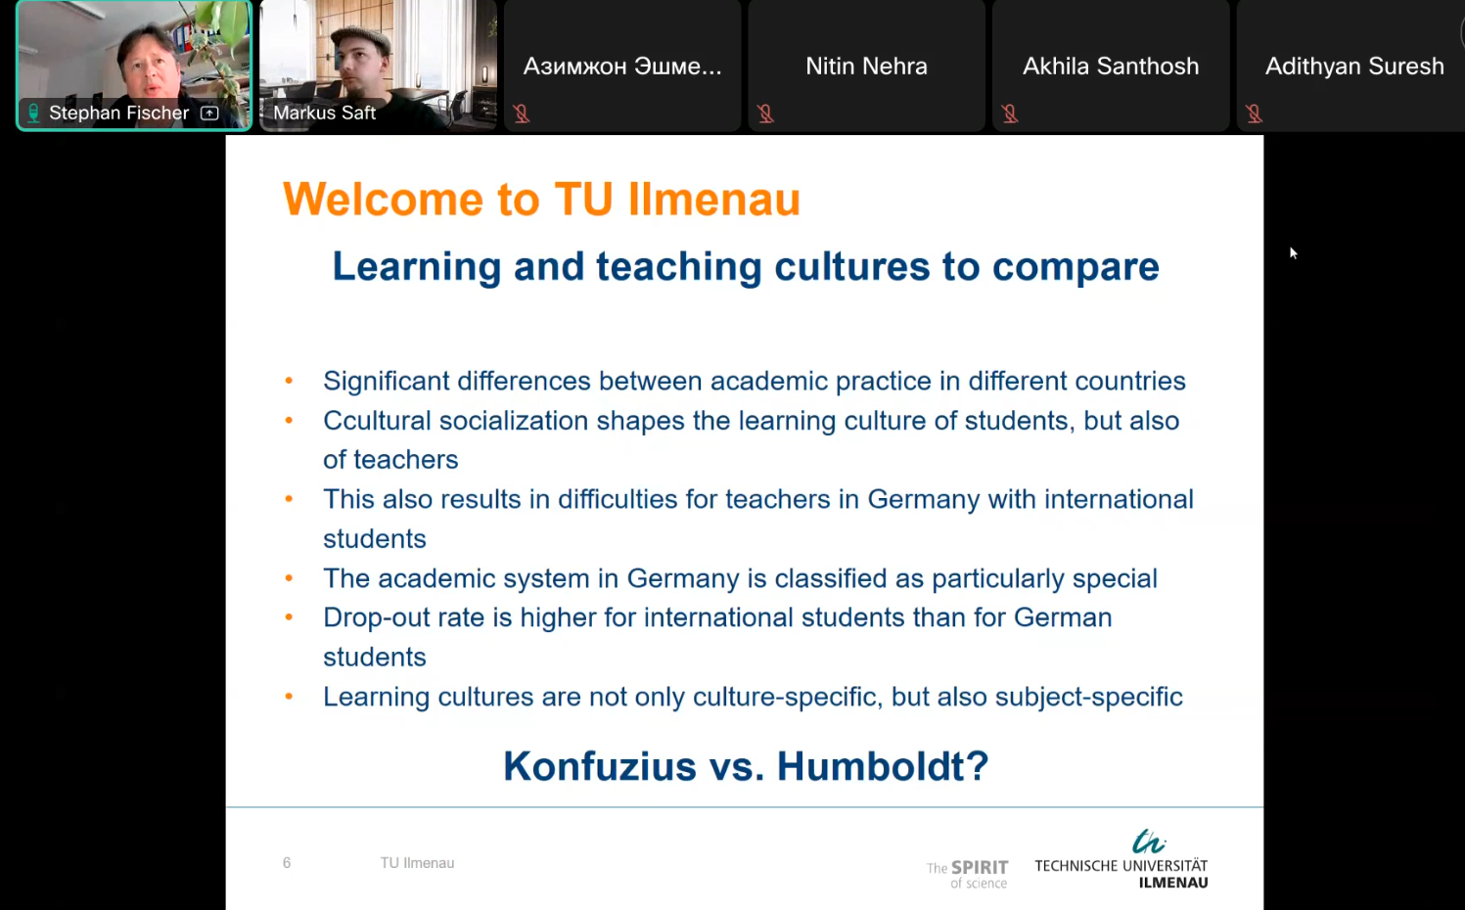
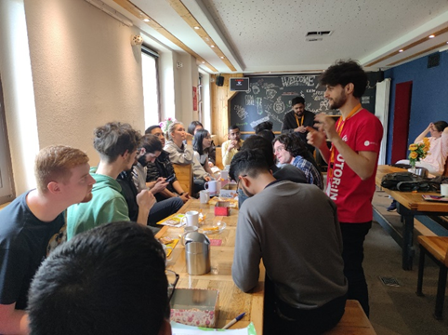
btw
Wednesday, 3 p.m.: - time!
before arrival: onboarding sessions
After arrival: coffee2meet
e.g. September 30 –
Open Q&A and Creating Your Timetable
e.g. October 14 –
we4you career counselling

Slide 6
Welcome to TU Ilmenau
Introduction
Topics
Working as a international student
Basics
How2earn – types of employment
Employment contract
Employment standards
Doubts – Who Can Help?
We4you career counseling
Let’s work together on your
application documents
tailor an application to a specific job opening,
set an appointment for a mock interview,
visit local companies and career fairs together, and get inputs during workshops

Slide 7
Welcome to TU Ilmenau
Most frequent advice we give:
Prepare you documents even if you don’t need them, yet.
Get an overview of jobs available
Learn German!!!!
… and have them checked
Fill gaps in your cv
Get enganged and show that you are able to integrate.
Build a network!

Slide 8
Welcome to TU Ilmenau
excursus – why work?
Networking and Sociocultural integration
Covering living costs
Adapt to German work culture
Build professional skills
boost CV
Sammeln internationaler Erfahrungen

Slide 9
Welcome to TU Ilmenau
excursus – more rule than exception
2.87 million students in Germany
~402,000 international students across Germany
63% of students work
-
approx. 1.81 million
61% of international students are employed
economic factor!

Slide 10

Welcome to TU Ilmenau
basics
German law – seems complex
BUT: not complicated
Clear rules, no room for interpretation

Slide 11

Welcome to TU Ilmenau
basics
Holy grail: §16b AufenthG📝
→ student residence permit – full-time studies
primarily intentions
→ studies are the main purpose🎓
→ Working alongside your studies 💼
we know that you have to work!
→ university staff
→ immigration office

Slide 12
Welcome to TU Ilmenau
basics
Labor law and residence law determine the rules
work up to 140 full days or 280 half-days/year
→ Up to 4 hours = half a day
→ Up to 8 hours = full day
Annual work-day allowance – automatically tracked
during lecture period: up to 20 hours/week
lecture-free period: more flexibility, you could work full-time

Slide 13
Welcome to TU Ilmenau
basics
rules are applied in the way most beneficial to you
theoretically no income limit
Minimum wage: €13.90 gross/hour
Freelance work can be paid below minimum wage
important exception
→ Student assistant jobs are not counted towards the 140-day limit
§ 16b allows you to study, work and gain valuable experience in Germany – while following the applicable rules

Slide 14
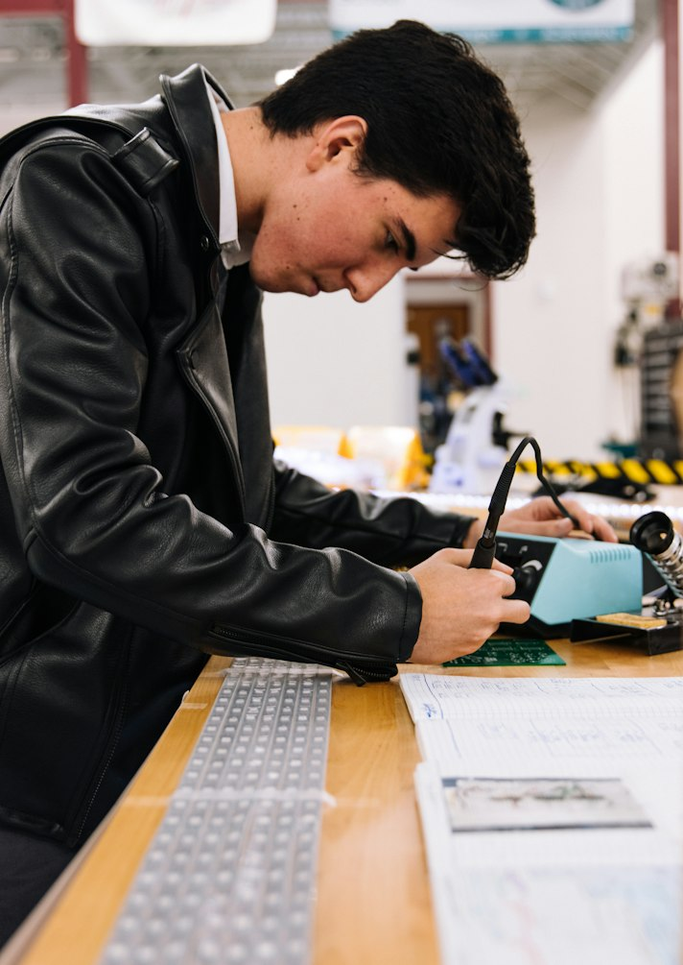
Welcome to TU Ilmenau
Types of employment
Working Student („Werkstudent“)
Minijob
Part-time job
Student Assistant (HiWi)
and
Research Assistant
Full-time job
(Exceptions: Internships)

Slide 15
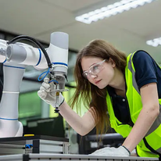
Welcome to TU Ilmenau
Working Student („Werkstudent“)
working part-time while being enrolled in full-time studies
20-hour-rule
→ up to 20 hours/week during lecture period
lecture-free period: increase hours, work up to full-time → attractive income
immigration law: studies remain your primary focus
labour law: „working student privilege“
→ exempt from paying health, long-term care,
unemployment insurance
→ more net from gross
btw: often STEM-related and within the region → ideal for you!

Slide 16
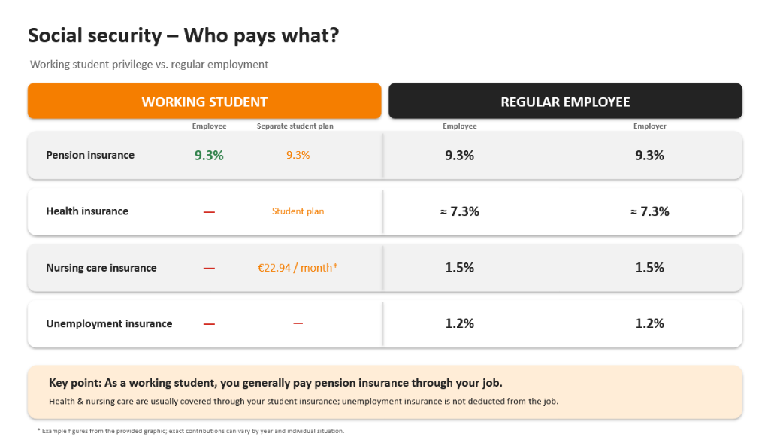
Welcome to TU Ilmenau
Working Student („Werkstudent“)
Or in short: the working-student perk means more money in your pocket

Slide 17

Welcome to TU Ilmenau
Minijob
marginal employment, requiring no qualifications
simplest unskilled casual jobs
income (almost) tax-free and exempt from social security contributions
minimal bureaucratic effort → flexibility
ideal during the semester break
ideal if you can only work a little
if you only need a small amount of extra income
income: €603 per month (or up to €7,236 per year)
max. 43.4 hours/month
Logistics, supermarkets, retails, cleaning, catering, office etc.

Slide 18


Welcome to TU Ilmenau
Part-time job
similar to a working-student job
→ attention to the job listing/employment contract
lecture period – up to 20 hours/week
lecture-free period – full-time employment
NOT tax-free nor social-security-free
health, long-term care, pension and unemployment insurance contributions, income tax
→ profitable in the long run
All possible industries

Slide 19
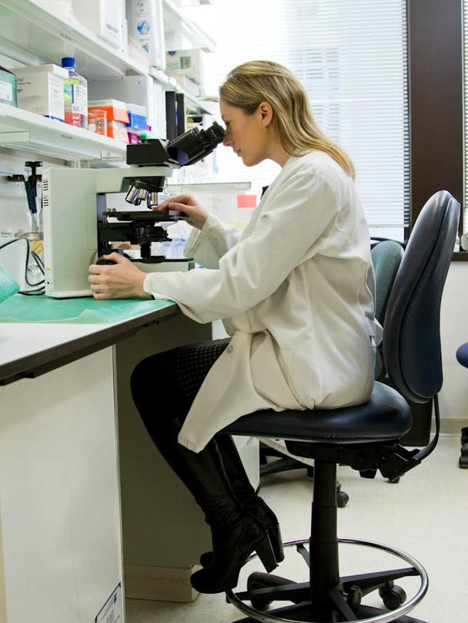
Welcome to TU Ilmenau
Student/Research Assistant
university or research institute
supporting professors, chairs, research projects
e.g. data analysis, programming, lab work, proofreading, tutorials, organizational tasks, literature research etc.
→ professional experience, practice, contacts
covered by collective agreement, employment for
at least 1 year, €15.20–16.70/hour
not automatically tax-free → amount of income
not subject to the 140-day limit
Communication is key → be proactive, approach staff

Slide 20

Welcome to TU Ilmenau
full-time job
not common, not recommended, not compatible with studies
→ 35–40 hours per week
→ conflict with the purpose of residence permit
income tax, full social-security contributions
BUT: generally possible, mind the 140-day rule
BUT: only during semester breaks, not during lecture periods
no additional permission by authorities required
Interested? → definitely get advice from we4you

Slide 21

Welcome to TU Ilmenau
Working contract
Duties and rights
Duties and rights
Employee
Employer

Slide 22
Welcome to TU Ilmenau
Working contract
What exactly will I do?
Who is my employer?
How can I terminate the contract?
Employment contract MUST include
When will I be paid?
How long is the contract valid?
How much will I earn
How many hours will I work?

Slide 23
Welcome to TU Ilmenau
Working contract
Don't sign any contracts that spell out exceptions or deviations
–
It won't work in your favor!

Slide 24
Welcome to TU Ilmenau
Working contract
read it carefully
watch out for contract penalties
have it checked

Slide 25


Welcome to TU Ilmenau
Employment standards
don't burn yourselves out
Working hours
→ 8h daily – 10h max – 11h rest
Breaks
→ 6–9h – min. 30 minutes
→ >9h – min. 45 minutes
→ duration min. 15 minutes
Breaks are not working hours

Slide 26
Welcome to TU Ilmenau
Employment standards
never go to work sick!
Illness
→ immediate notification to employer
Sick leave
→ 3-day rule – absent without medical report
→ from day 4 – doctor’s certificate
→ BUT: employer can require certificate from
Day 1 – check contract
Continued payment for 6 weeks

Slide 27
Welcome to TU Ilmenau
Employment standards
Don't worry if this sounds confusing
Whatever happens, no matter what kind of work setup you're in – you're always covered!

Slide 28

Welcome to TU Ilmenau
Employment standards
Termination
Always in a written form
With observance of notice period
Probationary period
→ during: 2 weeks
→ after: 4 weeks
→ elective on the 15th or 30th/31st of month
Beware: never sign a dissolution agreement!
Insist on remaining vacation days, pay, bonuses → HR or advisory can help you

Slide 29
Welcome to TU Ilmenau
That's it, we‘re (almost) done!
types of employment
employment contract
employment standards
lots of rules
lots of terms
try to keep the key points in mind
Job hunting and contract checks → get some advice!

Slide 30
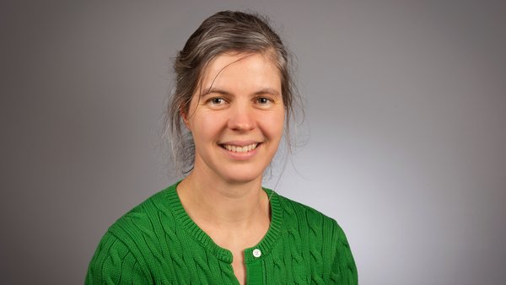
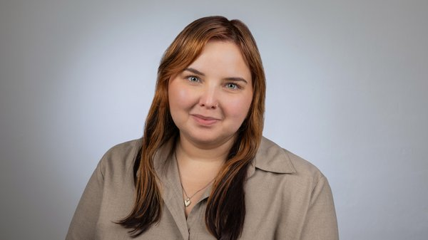

Welcome to TU Ilmenau
Doubts – Who Can Help?
we4you career counseling team
Natasha
natalia.sultanova@tu-ilmenau.de
Gesa
gesa.pries@tu-ilmenau.de
We offer consultations in-person and online, you can drop by on our open day or make an appointment, using this link:
https://turm2.tu-ilmenau.de/course/open?ID=1384

Slide 31
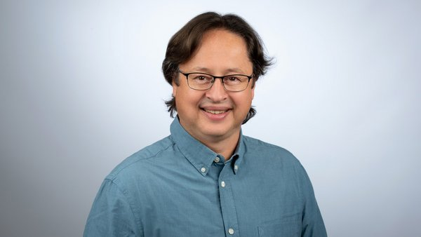
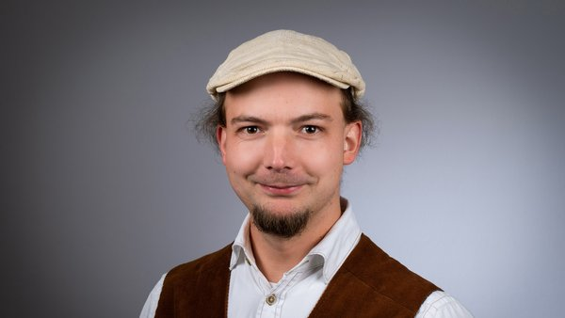
Welcome to TU Ilmenau
Doubts – Who Can Help?
we4you social counseling team
Markus – Counselling & Integration
markus.saft@tu-ilmenau.de
Stephan – International student advisory
stephan.fischer@tu-ilmenau.de

Slide 32


Welcome to TU Ilmenau
Doubts – Who Can Help?
Legal advice
→ Cooperation with a law firm
→ free consultation
→ in-house legal department

Slide 33

Welcome to TU Ilmenau
Doubts – Who Can Help?
Legal advice
→ Faire Integration Thuringia
→ Umbrella organization: largest union
→ specializes in residency and labor law
→ help quickly and easily
→ International advisors
Languages: German, English, Arabic, Dari, Pashto, Urdu, Russian…
faire-integration@dgb-bwt.de // 0361 21727-16

Slide 34
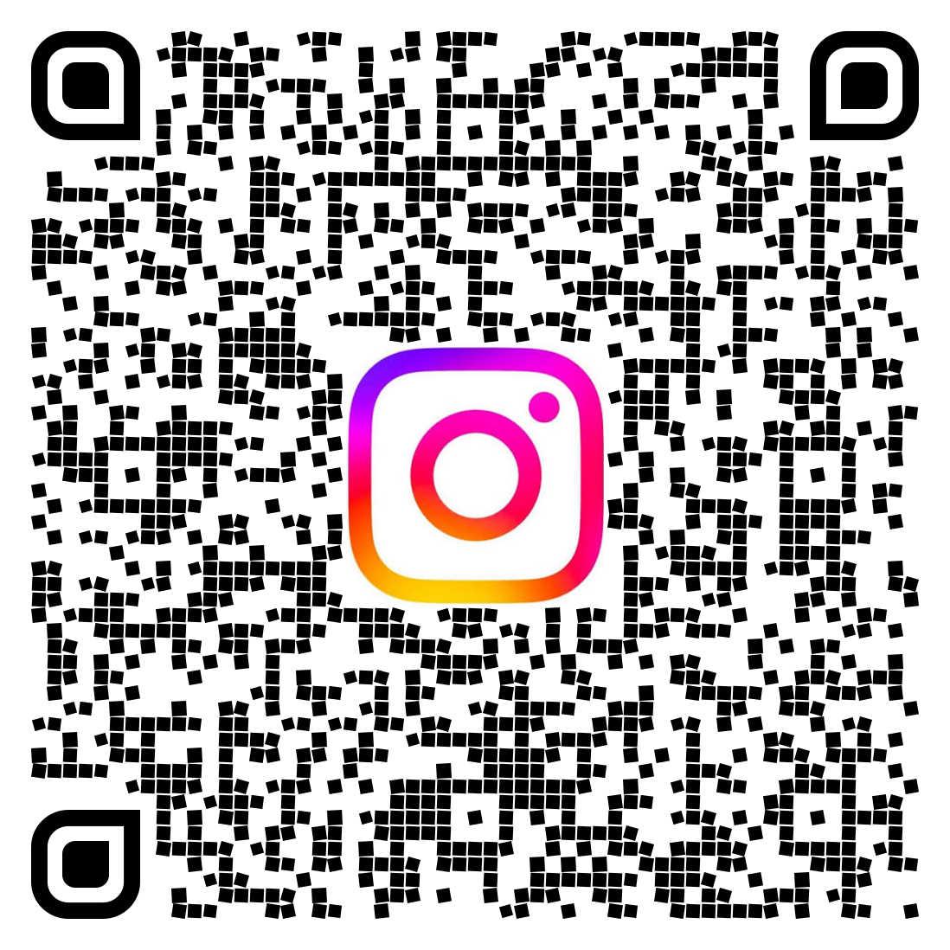
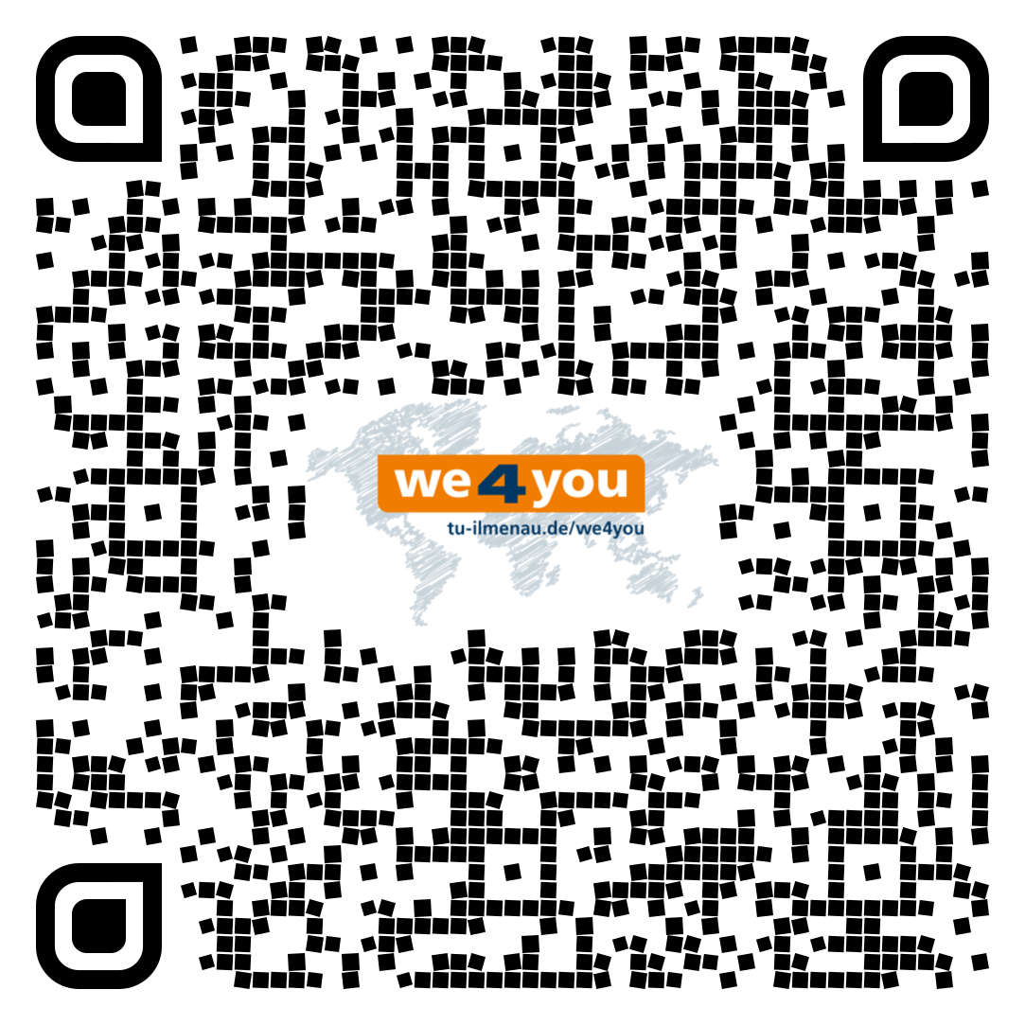
Welcome to TU Ilmenau
i
Instagram – consultation, events, impressions
Arrival – onboarding, contacts, Q&A, checklists, …

Slide 35

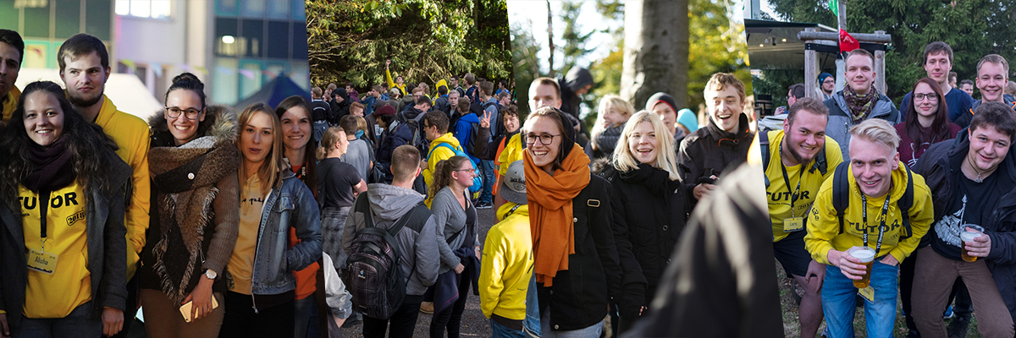
Welcome to TU Ilmenau
Freshers Week

Slide 36
Welcome to TU Ilmenau
Next online onboarding session of we4you
Wednesday, September 30, 2026, 3 p.m.
“Open Onboarding Session – Final Questions Before the Start of Studies”
Always check
www.tu-ilmenau.de/arrival

Slide 37


Welcome to TU Ilmenau
Enough from me – let's pass the mic to Isha for a firsthand perspective🎤

Slide 38
Thank you! Q&A session
Credits: p. 1: Chris Liebold, p.2: Stadtverwaltung Ilmenau, p. 3: Nürnberg Luftbild / Hajo Dietz, p.4/1: TU Ilmenau, p. 4/2&3: Michael Reichel p. 5/1 iStockphoto.com/Creativeye99 p. 5/2 Siemens AG, p. 5/3-5/5: Michael Reichel, p. 9: helibild, p. 10: Michael Reichel, p. 12: Beatrice Einecke, p. 13: helibild

