Slide 1

Welcome to TU Ilmenau
Preparing and starting your studies
- Online Onboarding Session, September 2, 2026

Slide 2

Welcome to TU Ilmenau
Preparing and starting your studies
Intro
Intro
Today’s schedule:
Welcome and warm up
Introductory presentation
Questions & Answers
Hosts:
Presenter - Markus Saft, we4you, students support network
Chatmaster – Isha Sudele, we4you, student assistant

Slide 3
Welcome to TU Ilmenau
Preparing and starting your studies
Welcome and warm up
Get to know us.
What about you? Please communicate shortly via chat.
Let’s start!
It’s our idea, to make the introductory presentation in block to remain in the time line.
Q&A session follows afterwards. However, you can write connected questions in the chat.

Slide 4




Welcome to TU Ilmenau
we4you – your international Studentservice!
We provide the ultimate guide:
Your Start in Ilmenau – Arrival Website for International Students

Slide 5

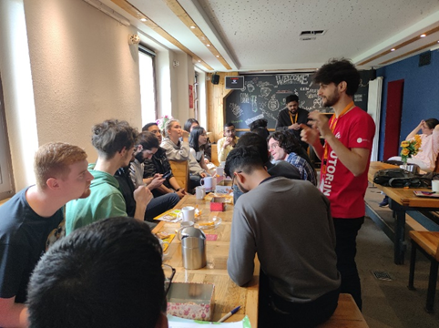
btw
Wednesday, 3 p.m.: - time!
before arrival: onboarding sessions
on site: coffee2meet

Slide 6


Welcome to TU Ilmenau
Introduction
administrative
Semester dates
recommended arrival
Admission status -
Kinds of admissions
Enrollment
Dates and procedures
Topics
socialize
Travel and reach Ilmenau
After arrival
What is your expectation?
Does it match?
Fresher’s week
Late arrival

Slide 7
Welcome to TU Ilmenau
1. Semester dates
Enrollment possible:
Administrative start of the semester:
Introduction days:
Start of the Lectures:
Lecture period:
Examination period:
Beware:
Right at the start of the semester, we celebrate Unification Day in Germany – the university will be closed October 3rd.
until October 30th
October 1st, 2026
4 – 10 October
October 12th
October 12th – Feb 5th
Feb 15th – March 25th
Link

Slide 8
Welcome to TU Ilmenau
recommended arrival
Arrival:
Highly recommended - have your arrival completed before October 2nd
As a rule of thumb:
Later arrival will make your study start much harder!
(*we’ll get back to “later arrival” at the end of the presentation.)

Slide 9

Welcome to TU Ilmenau
else you’ll miss
Intro to the course
first lectures
intro to the department
mentoring students
Information study organization
necessary information about subject

Slide 10
Welcome to TU Ilmenau
2. Admission status – What does it mean?
Admission: direct or conditional?
Direct:
enrollment directly into you subject studies
possible before arrival online (recommended)
2. Conditional: Language condition to fulfill before starting the subjects
provide C1 level certificate -> then equal to direct admission
join language course in Germany, e.g. in Ilmenau

Slide 11


Welcome to TU Ilmenau
2. Admission status – What does it mean?
direct admission:
enrollment directly into you subject studies
possible before arrival online (recommended)
2. Conditional admission:
Language condition to fulfill before starting the subjects
provide C1 level certificate -> then equal to direct admission
join language course in Germany, e.g. in Ilmenau

Slide 12
Welcome to TU Ilmenau
Admission status – Language courses
Language conditions
German Language Course in Ilmenau:
Apply until September 27th, don’t use mobile devices
Placement test on-site(!) on October 1st
Course starts October 12th
late entry to be managed with course provider in advance

Slide 13
Welcome to TU Ilmenau
Admission status – Language courses
Language conditions
English Language Course in Ilmenau:
Apply from now, don’t use mobile devices
Placement test on-site(!) and start of course October 13th
late entry to be managed with course provider in advance
Add on to Language preparation:
accepted language certificates
Links to Ilmenau course provider
German course English course
Courses run for one semester

Slide 14
Welcome to TU Ilmenau
Enrollment
Enrollment options
  on direct admit: possible any time up to October 31st
  with condition: any time up to October 31st with C1 level certificate
  with condition + taking part in Ilmenau language course:
  after arrival, after placement test

Slide 15
Welcome to TU Ilmenau
Enrollment
btw: Even as an APC-student, you have regular student status with all the associated benefits.
Tutors and Buddys
Counselling and support
Events
Sociocultural integration
Sammeln internationaler Erfahrungen

Slide 16


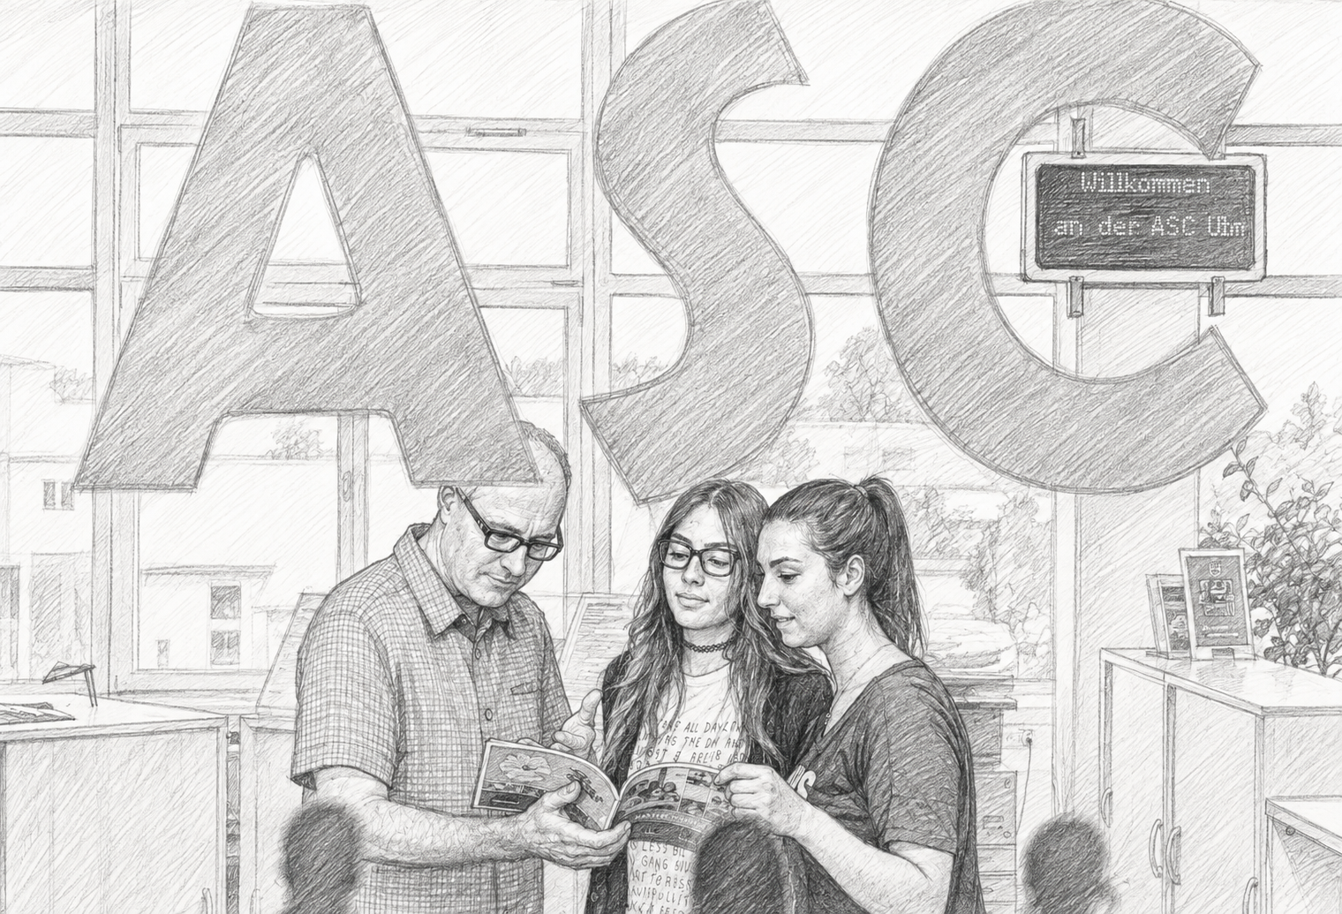


Welcome to TU Ilmenau
Enrollment
Enrollment completed
proof of health insurance
M10

Slide 17
Welcome to TU Ilmenau
Enrollment
Enrollment completed
payment of semester fee
Campus Portal
→
Student Services section
→
Payments and bank details
Wintersemester 26/27:
351,80€

Slide 18


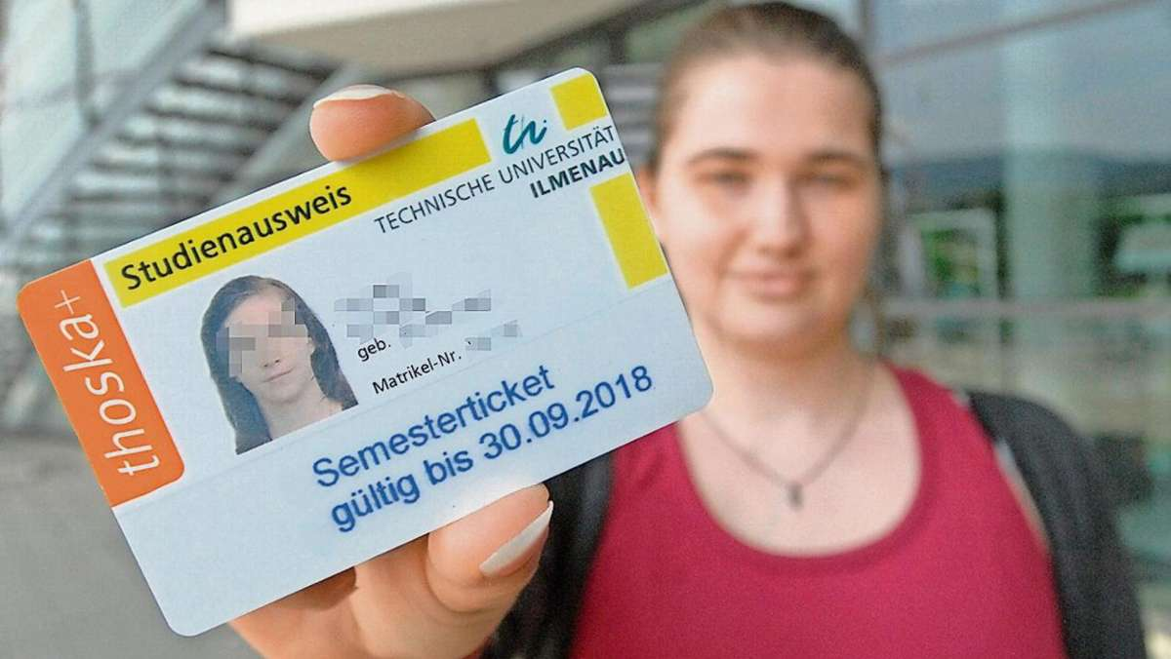
Welcome to TU Ilmenau
Enrollment
Enrollment completed
email confirming completed enrollment
email about how to activate your university accounts
Access to student campus portal by your new TU Ilmenau account
student ID-Card

Slide 19
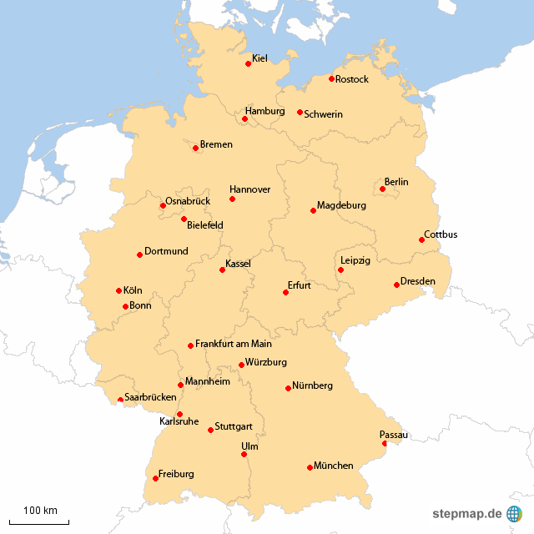
Welcome to TU Ilmenau
Travel and reach Ilmenau

Slide 20
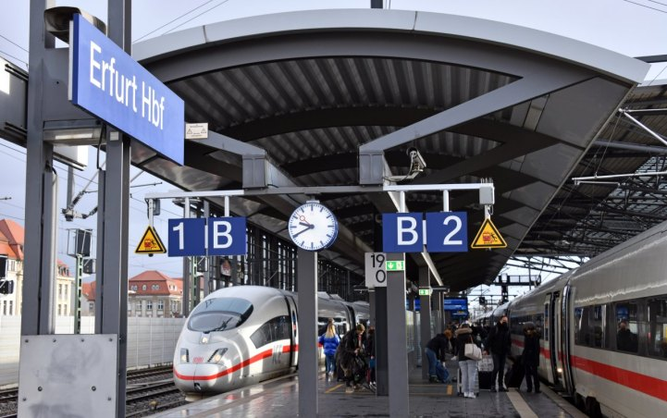
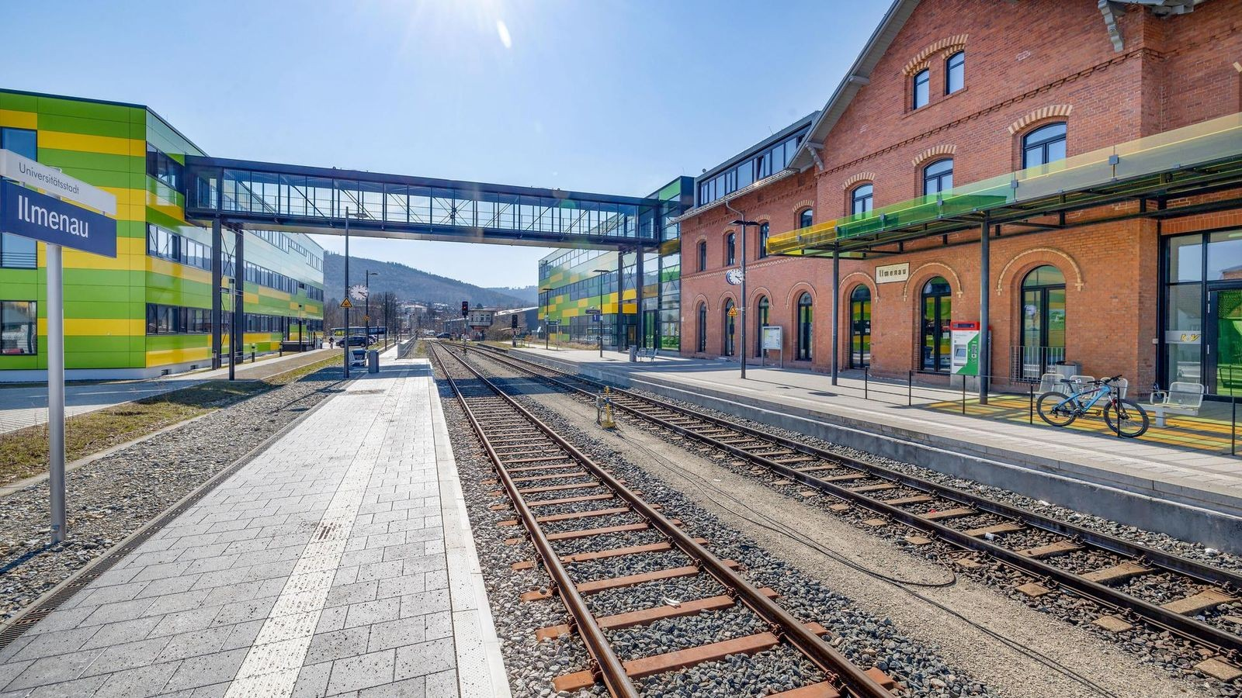
Welcome to TU Ilmenau
Travel and reach Ilmenau
~1h

Slide 21
Welcome to TU Ilmenau
Travel and reach Ilmenau
Switch the train in Erfurt to “Ilmenau”
check times, no night train!
Attention: Train can have to sections. It will be separated in “Arnstadt Hauptbahnhof”. One part goes to Ilmenau, other to “Saalfeld”. Check Ilmenau section!
Ilmenau has different train stations
→ take Main Station, 15 minutes to walk to Campus

Slide 22
Welcome to TU Ilmenau
Travel and reach Ilmenau
Check access to your accommodation in advance!
  Might not be possible in the evening, at night, at weekends or public holidays
  Keep Unification Day in mind and, if necessary, arrange short-term accommodation
Request support by your dorm administrator in good time in advance
  Pay attention to availability
  Arrange a key handover early
  Check your emails and, if applicable, the lease agreement; use the contact details provided

Slide 23
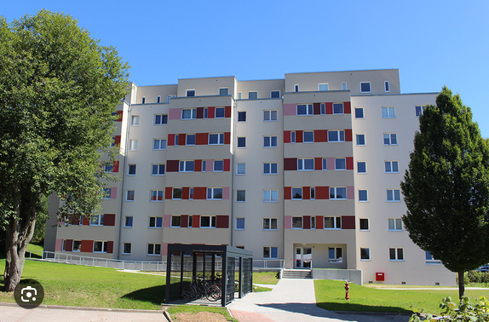
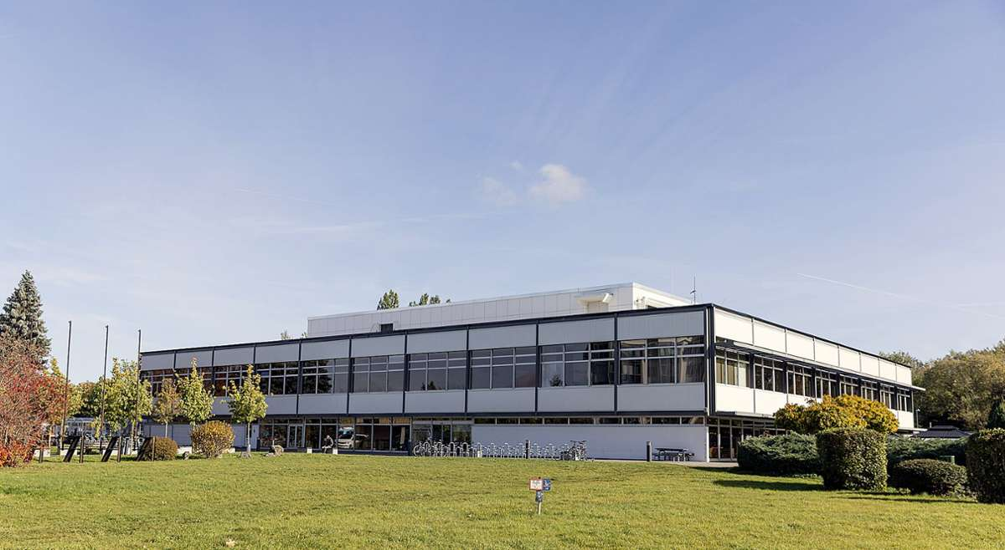
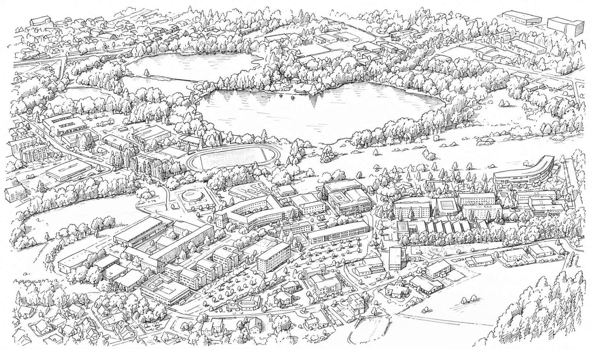
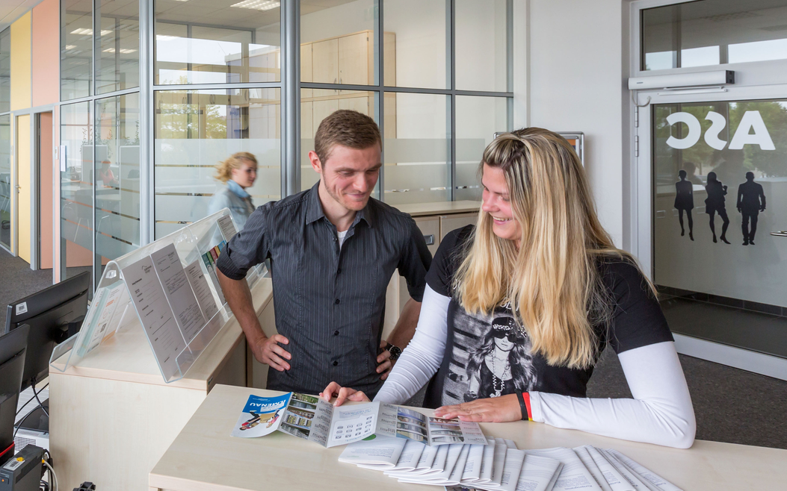
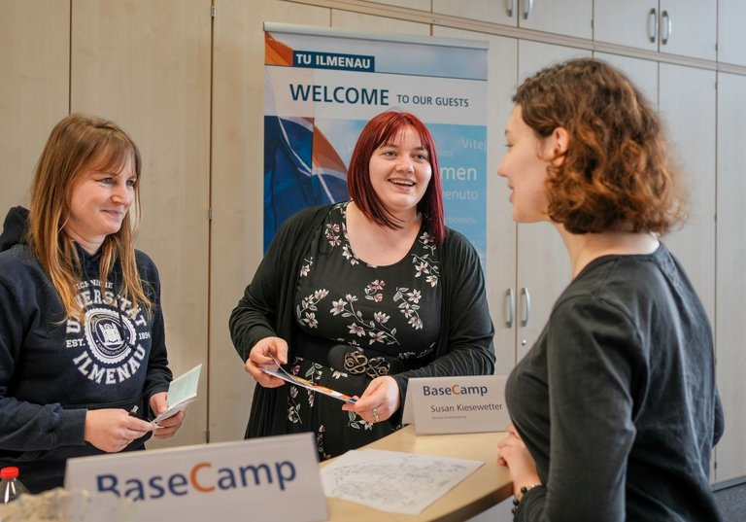
Welcome to TU Ilmenau
After arrival
Arrive, Settle and get familiar with the surrounding
housing department
Mensa
much more…
BaseCamp
ASC

Slide 24
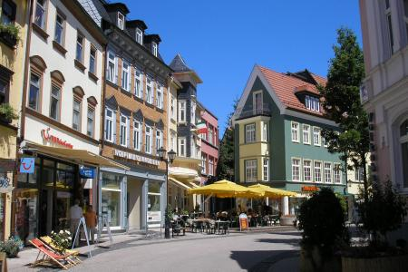
Welcome to TU Ilmenau
After arrival
  Supermarkets
  Drugstores
  City-administration
  Foreigner’s Authority
  Clothing Stores
  Cafés and Bars
  Gyms

Slide 25
Welcome to TU Ilmenau
Starting your studies
Studying abroad is a challenge - everything will be different
Studying = full time job - expect to do it around 40 hours/week
Sounds hard, but …
as University we expect you
  to arrive in time
  take part in introduction events
  join all lectures, get every information about lecture content
  prof’s expectations for study work and exams and dates and deadlines for everything

Slide 26
Welcome to TU Ilmenau
Starting your studies
as we4you we support you
  Weekly information events with staff members and tutors
  Confidential advice and support from Monday to Thursday on all kinds of topics
  Support programs
  Leisure and culture
  Connecting with fellow students and student organizations

Slide 27
Welcome to TU Ilmenau
Starting your studies.
What is your expectation? Does it match?
Of course we will guide you with supporting offers. Use it!
Don’t miss our online arrival session in March
  German courses and language acquisition – March 11th
  Learning and teaching culture in Germany – March 18th
  Financing your studies and student employment – March 25th
A later arrival is possible, but not recommended.
It needs to be managed actively and you should expect difficulties.
  How to manage your Late Arrival – April 22nd

Slide 28

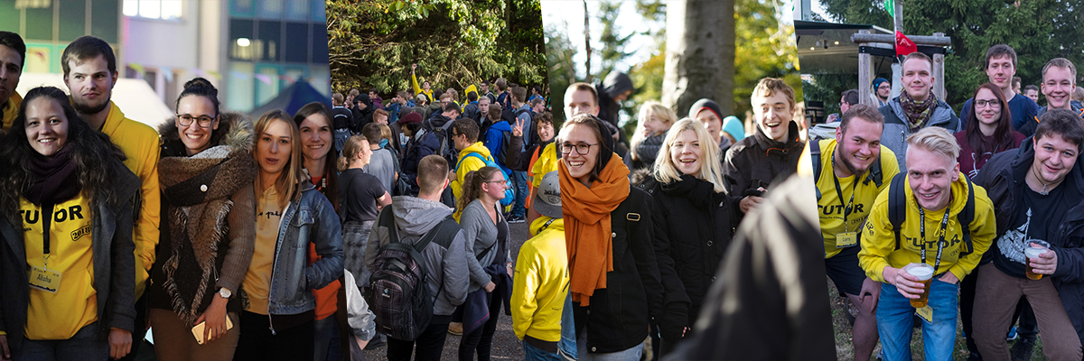
Welcome to TU Ilmenau
Freshers Week

Slide 29

Welcome to TU Ilmenau
Freshers Week
October 4 – October 10
Week program for all students
General information, University Services, Library, Computer Center, Sports, Get to know our advisory teams and your tutors (mentoring students)
Special program
Information of your department, especially related to your course work and schedule
PROGRAMME

Slide 30
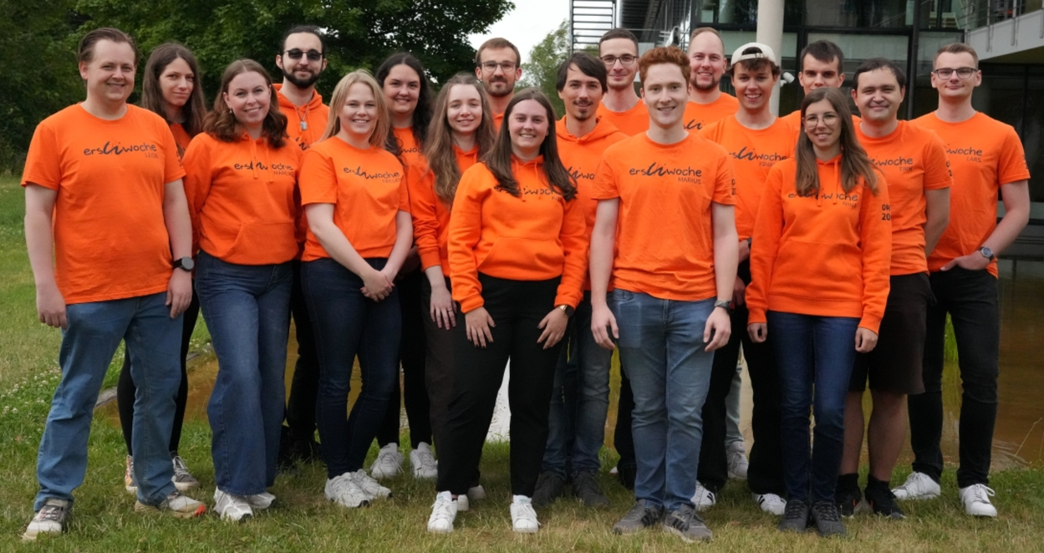
Welcome to TU Ilmenau
Freshers Week
„EWO-Tutors“
Daily Breakfasts
Info-Booth Mensa
Handing out Badges
culture/leisure in afternoon/ evening
Welcome BBQ, Movienight, Hike, City-Rallye…

Slide 31
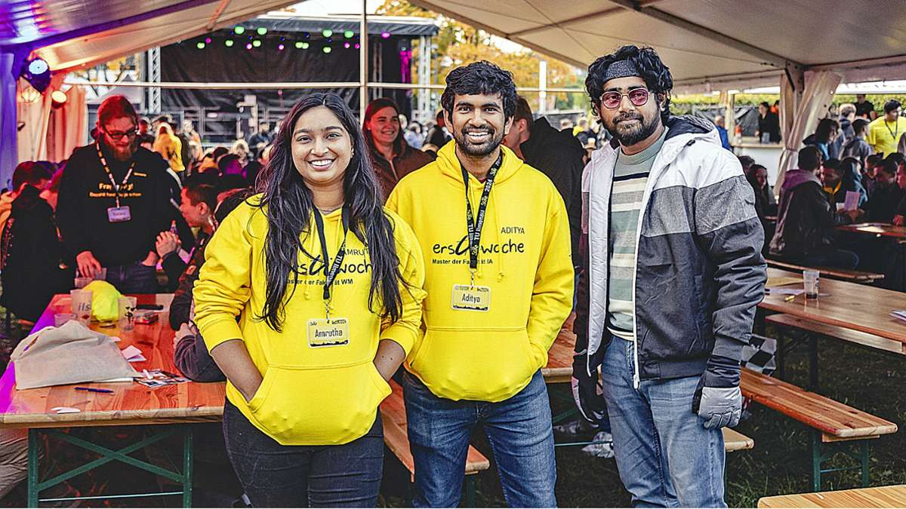
Welcome to TU Ilmenau
Freshers Week
„Faculty-Tutors“
Study Organization
Contact with the faculty / examination office
Guidance on the curriculum
Module list/schedule
Organize meetings
Guide you through events
Campus Walk

Slide 32
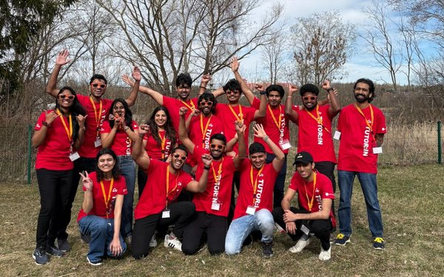
Welcome to TU Ilmenau
Freshers Week
„we4you-Tutors“
your go-to guys for everything
Questions / Problems / Contacts
coffee2meet Kick-off
we4you Programme

Slide 33
Welcome to TU Ilmenau
After Freshers Week…
...we continue with
International AND German students
Counselling and support
Events
Sociocultural integration
Sammeln internationaler Erfahrungen

Slide 34
Welcome to TU Ilmenau
Late arrival
Late arrival is possible once you are enrolled for the semester
(enrollment deadline April 30, 2026 for summer semester)
You do not need any permit. You can download late arrival letter from applicant portal, start page, section “useful documents”
Your studies start at the beginning of the semester, independent of whether you are at the university or not
You are in charge to re-capture missed information and lectures

Slide 35

Welcome to TU Ilmenau
...but what if you’re late?
Late arrival →
in SS26, ~50% of first-year students arrived after April 1

Slide 36


Welcome to TU Ilmenau
Late Arrival
Social stressors…
Administrative...
bank account
Tax ID
broadcasting fee
Foreigners’ authority
city administration
Study organization
Accommodation
Rental agreement
WiFi and mobile
Health insurance
Language barriers
Jobbing + finances

Slide 37
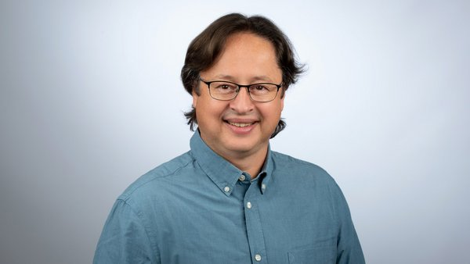
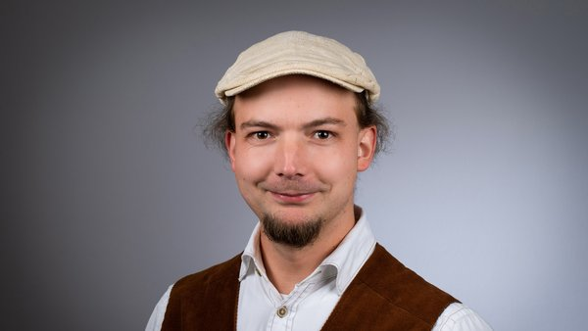

Welcome to TU Ilmenau
C O M M U N I C A T I O N ! ! !
Markus – Counselling & Integration
markus.saft@tu-ilmenau.de
Stephan – International student advisory
stephan.fischer@tu-ilmenau.de

Slide 38
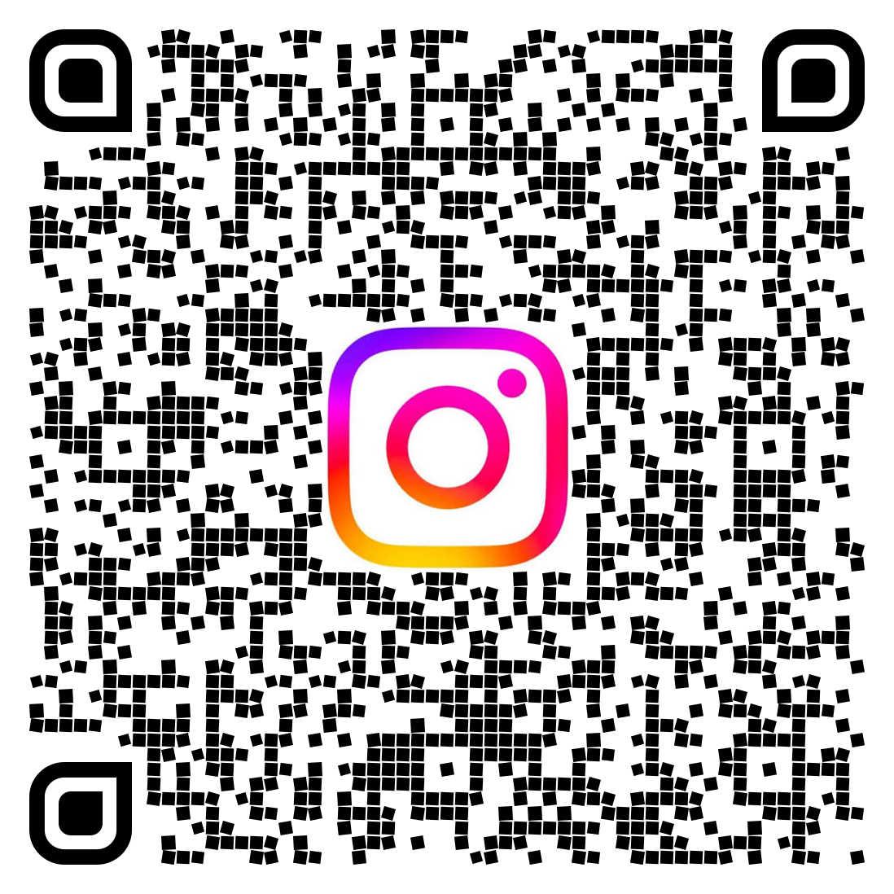
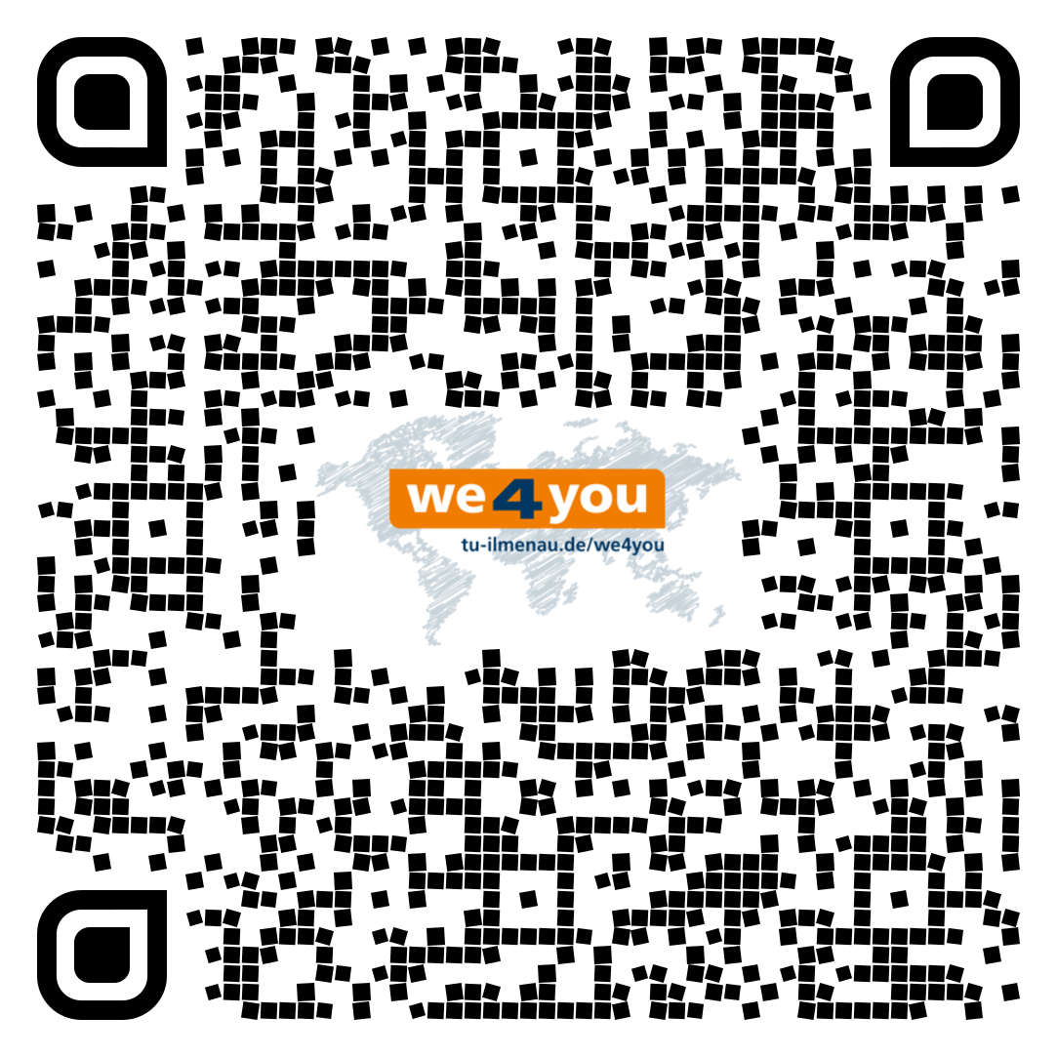
Welcome to TU Ilmenau
i
Instagram – consultation, events, impressions
Arrival – onboarding, contacts, Q&A, checklists, …

Slide 39
Welcome to TU Ilmenau
Next online onboarding session of we4you
Wednesday, September 9, 2026, 3 p.m.
“German courses and language acquisition”
Always check
www.tu-ilmenau.de/arrival

Slide 40


Welcome to TU Ilmenau
Enough from me – let's pass the mic to Isha for a firsthand perspective🎤

Slide 41
Thank you! Q&A session
Credits: p. 1: Chris Liebold, p.2: Stadtverwaltung Ilmenau, p. 3: Nürnberg Luftbild / Hajo Dietz, p.4/1: TU Ilmenau, p. 4/2&3: Michael Reichel p. 5/1 iStockphoto.com/Creativeye99 p. 5/2 Siemens AG, p. 5/3-5/5: Michael Reichel, p. 9: helibild, p. 10: Michael Reichel, p. 12: Beatrice Einecke, p. 13: helibild

